Slide 1


Page Rendering Strategies & Use Cases
Notes:
We can create awesome web applications and websites with the technologies we have right now, but there’s still a performance that needs to be considered. And at that point, there are many discussions on the way, applications should be rendered.

Slide 2


Agenda
1 | Different Page Rendering Strategies
2 | Architecture of CSR, SSR, SSG, ISR
3 | Use Cases with NextJs
4 | Q&A
 | Latest status of QE Accelerators

Slide 3
Menti

Slide 4




Different Page Generation Techniques
CSR – Client-Side Rendering
SSR – Server-Side Rendering
SSG – Static-Site Generation
ISR – Incremental-Site Regeneration

Slide 5



CSR – Client-Side Rendering
User Request
a Website
Server sending HTML
files with JavaScript links
Browser downloads HTML, CSS and JS and execute
Browser start showing
the website
When to use CSR?
Highly dynamic content
Not rely on SEO
Can be used to create rich site interaction
Dynamic Form
When not to use CSR?
SEO is the important consideration of app
Need fast initial load and interaction time.
Notes:
SSR – Need to talk about for all routes server will send same HTML and on client side after executing of JS actual data loaded

Slide 6
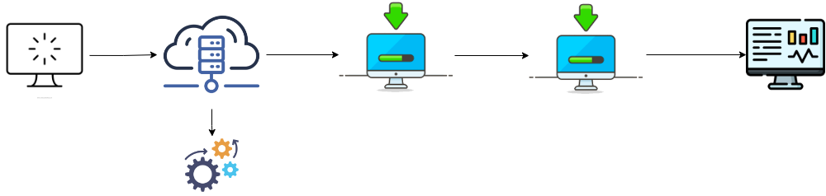
SSR – Server-Side Rendering
User Request
a Website
Browser receive prepared html file but not interactive
Browser downloads JavaScript and execute
Browser start showing
the website
Server start preparing ready html file
When to use SSR?
Need fast initial load and interaction time
Along with SEO is the important part of app
When not to use SSR?
Don’t need to render the data during the request
SEO is not the important part of app
Save server computation cost as every request is process on the server
Notes:
SSR – Need to talk about for all routes server will send same HTML and on client side after executing of JS actual data loaded

Slide 7

SSG – Static-Site Generation
Ci/CD – Fetch data from DB/API and prepare HTML, JSON and place them on server
Server send prepared HTML
and JSON to client
Browser receive prepared html file with JSON
User Request and Browser start showing the website
When to use SSG?
Blazing fast initial load time with little/no server process
SEO is the important part of app
More secure app as pages and data got pre-baked on build time
When not to use SSG?
SEO is not the important part of app
Highly dynamic content
Frequently changes on page.
Less build time.
Notes:
SSR – Need to talk about for all routes server will send same HTML and on client side after executing of JS actual data loaded

Slide 8
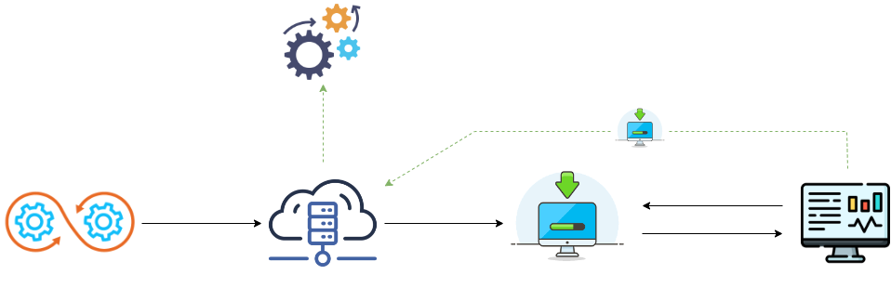
ISG/ISR – Incremental-Site Generation/Regeneration
Server start preparing HTML, JSON file with ready to use state
Ci/CD – Fetch data from DB/API and prepare HTML, JSON and place them on server
New request for new page which not generated on build time
Server send prepared HTML, JSON to client
Browser receive prepared html file with JSON
User Request and Browser start showing the website
When to use ISG/ISR?
Don’t want to generate all pages on build time to save build processing time
Revalidate data of generated pages on time based or on-demand

Slide 9

Use Cases

Slide 10

Use Cases for CSR, SSR, SSG, ISR
App should have capability to search location through google map.
Application have 4000+ of records to display
Data going to be update on daily basis(24hrs)
SEO is key part of application. Should be able to crawlable by search engines
Should support localization (en-us, es, fr)
Low server cost
CSR – Client-Side Rendering
SSG – Static Generation
SSR – Server-Side Rendering
Notes:
Talk in Numbers how much time spent on average on project setup and all code quality tools setup , pipelines etc
2-3 sprints

Slide 11

Use Cases with CSR
App should have capability to search location through google map.
Application have 4000+ of records to display
Data going to be update on daily basis(24hrs)
SEO is key part of application. Should be able to crawlable by search engines
Should support localization (en-us, es, fr)
Low server cost
CSR – Client-Side Rendering
Notes:
Talk in Numbers how much time spent on average on project setup and all code quality tools setup , pipelines etc
2-3 sprints

Slide 12
Use Cases with CSR + SSR
App should have capability to search location through google map.
Application have 4000+ of records to display
Data going to be update on daily basis(24hrs)
SEO is key part of application. Should be able to crawlable by search engines
Should support localization (en-us, es, fr)
Low server cost
CSR – Client-Side Rendering
SSR – Server-Side Rendering
Notes:
Talk in Numbers how much time spent on average on project setup and all code quality tools setup , pipelines etc
2-3 sprints

Slide 13
Use Cases with CSR + SSG
App should have capability to search location through google map.
Application have 4000+ of records to display
Data going to be update on daily basis(24hrs)
SEO is key part of application. Should be able to crawlable by search engines
Should support localization (en-us, es, fr)
Low server cost
CSR – Client-Side Rendering
SSG – Static Generation
Notes:
Talk in Numbers how much time spent on average on project setup and all code quality tools setup , pipelines etc
2-3 sprints

Slide 14
Use Cases with CSR + ISG
App should have capability to search location through google map.
Application have 4000+ of records to display
Data going to be update on daily basis(24hrs)
SEO is key part of application. Should be able to crawlable by search engines
Should support localization (en-us, es, fr)
Low server cost
CSR – Client-Side Rendering
ISG/ISR – Incremental Site Generation/Regeneration
Notes:
Talk in Numbers how much time spent on average on project setup and all code quality tools setup , pipelines etc
2-3 sprints

Slide 15
But Why NextJs?
1 | NextJs is an open-source, flexible React framework that gives us building blocks to create fast web applications.
2 | Handle the tooling and configuration needed for React app
3 | Default support of CSR, SSR, SSG and ISR.
4 | File system-based routing, locale support, handling security headers, redirect/rewrite rules
 | Latest status of QE Accelerators
Notes:
Just talk about this slide instead of showing

Slide 16
Demo

Slide 17
Re-cap

Slide 18
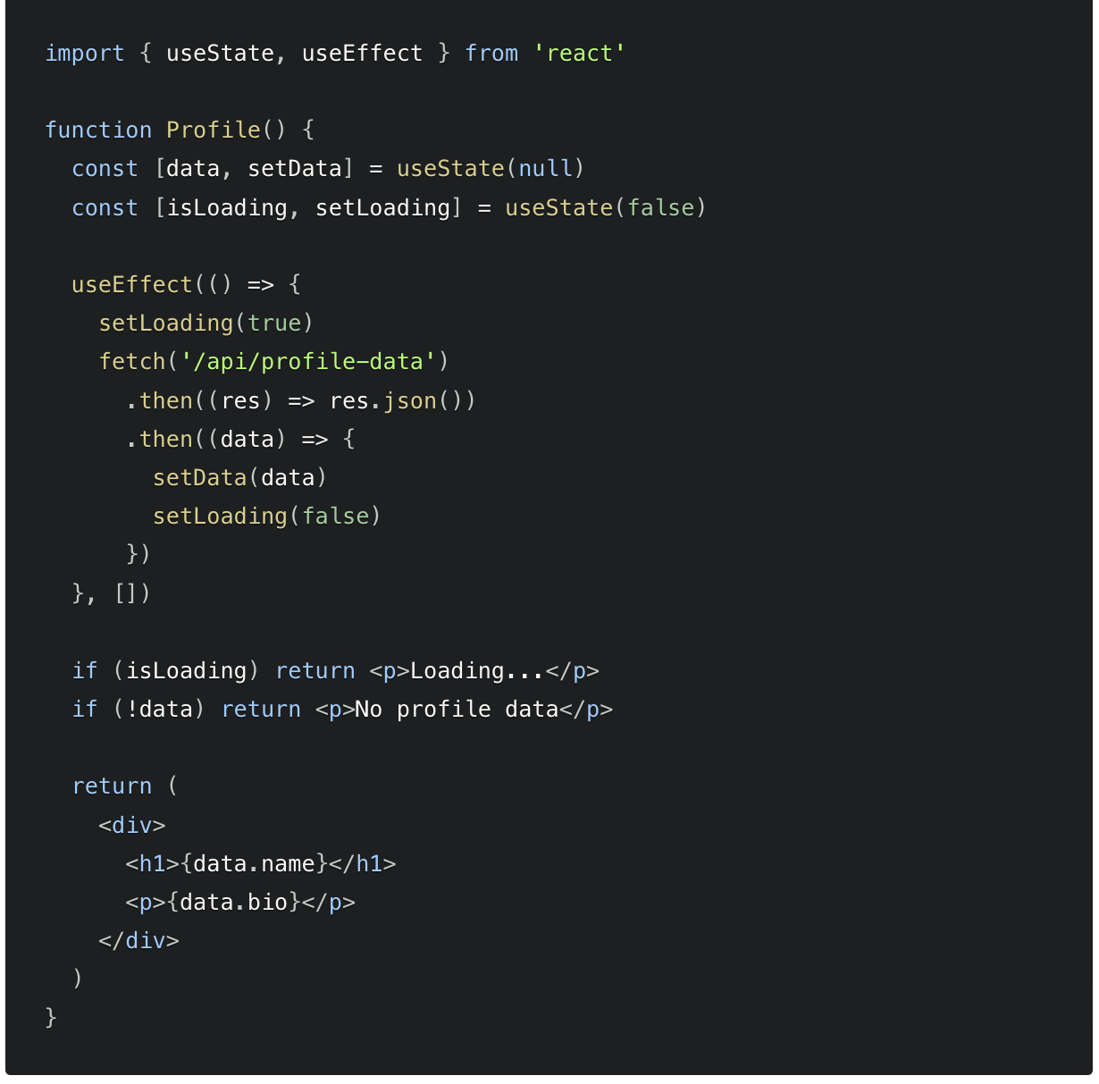
Client-side Rendering and Data Fetching
Client-side data fetching is useful when your page doesn't require SEO indexing, when you don't need to pre-render your data, or when the content of your pages needs to update frequently.
The following example shows how you can fetch data on the client side using the useEffect hook.
It's important to note that using client-side data fetching can affect the performance of your application and the load speed of your pages.
Notes:
Use different slides for csr, ssr,ssg,isr

Slide 19
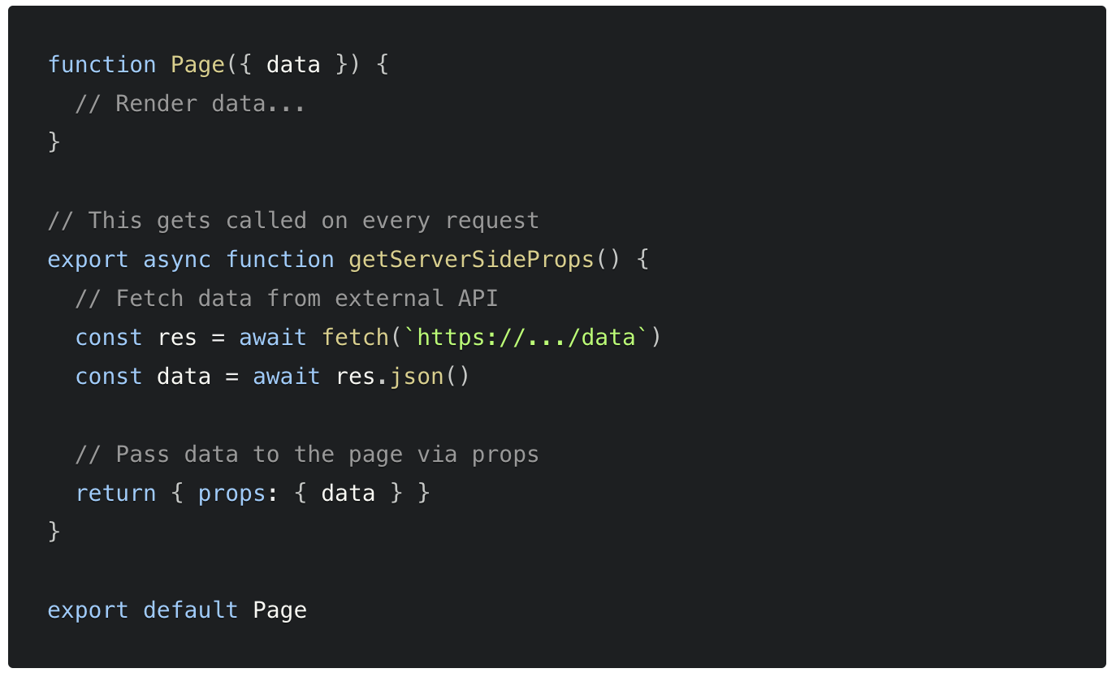
Server-side Rendering and Data Fetching
If you export a function called getServerSideProps (Server-Side Rendering) from a page, Next.js will pre-render this page on each request using the data returned by getServerSideProps.
The following example shows how you can fetch data on the server side using the getServerSideProps hook.
When should I use getServerSideProps
You should use getServerSideProps only if you need to render a page whose data must be fetched at request time and along with SEO is important part of the app
Notes:
Use different slides for csr, ssr,ssg,isr

Slide 20
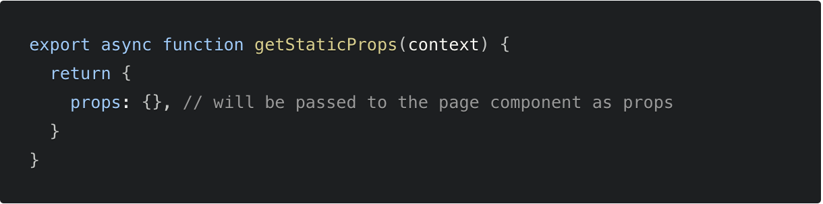
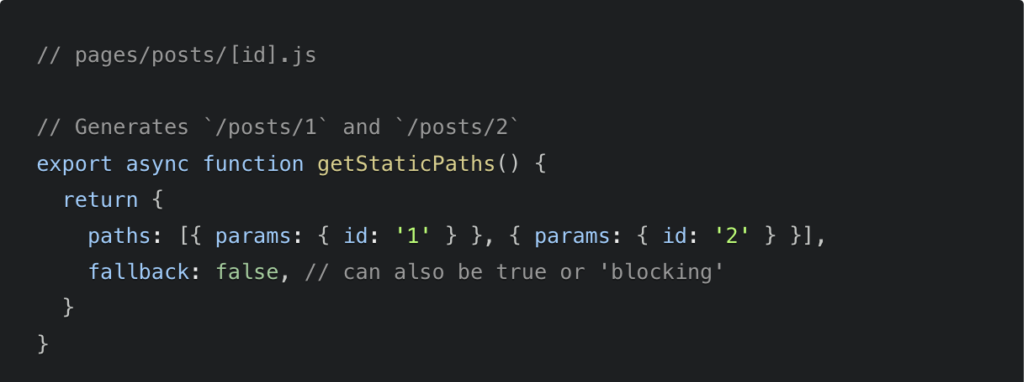
SSG – Static Site Generation
Using SSG allows you to create pages on build time ahead of a user’s request. If a page has Dynamic Routes and uses getStaticProps, it needs to define a list of paths to be statically generated.
When you export a function called getStaticPaths(Static Site Generation) from a page that uses dynamic routes, Next.js will statically pre-render all the paths specified by getStaticPaths.
Notes:
Talk in Numbers how much time spent on average on project setup and all code quality tools setup , pipelines etc
2-3 sprints

Slide 21
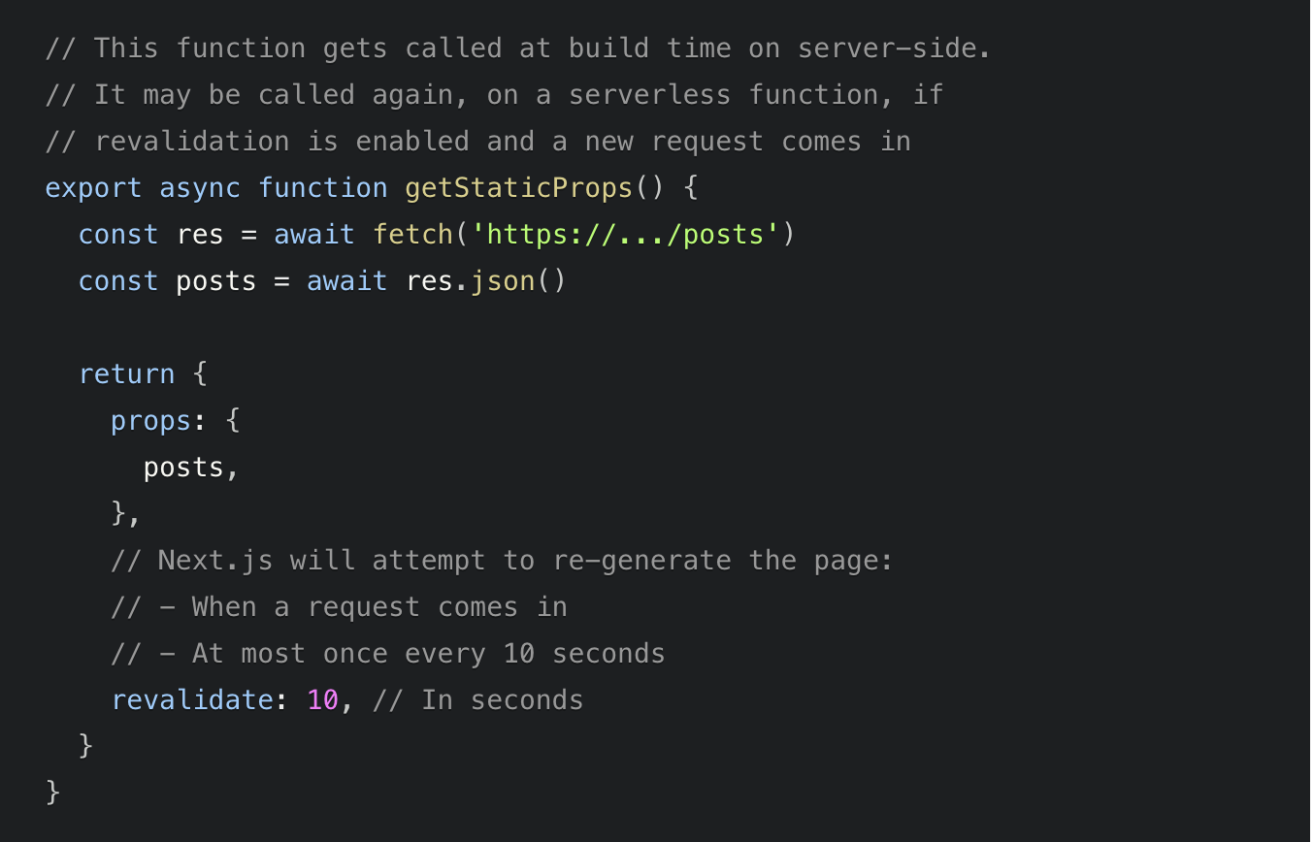
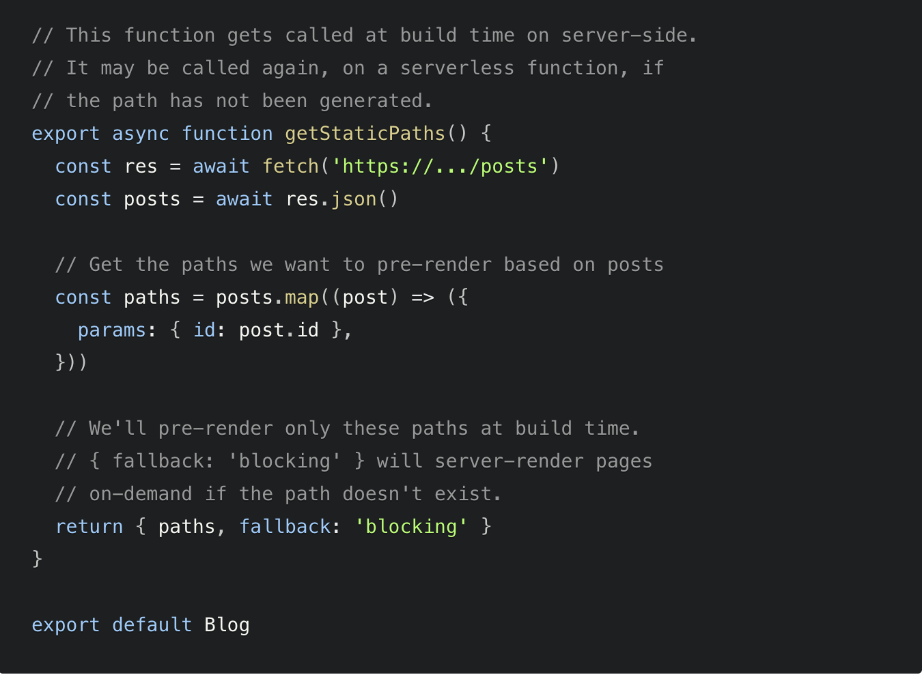
ISG/ISR – Incremental Site Generation/Regeneration
Next.js allows you to create or update static pages after you’ve built your site. Incremental Static Regeneration (ISR) enables you to use static-generation on a per-page basis, without needing to rebuild the entire site. With ISR, you can retain the benefits of static while scaling to millions of pages.
Notes:
These examples are time based revalidation of the pages after build

Slide 22
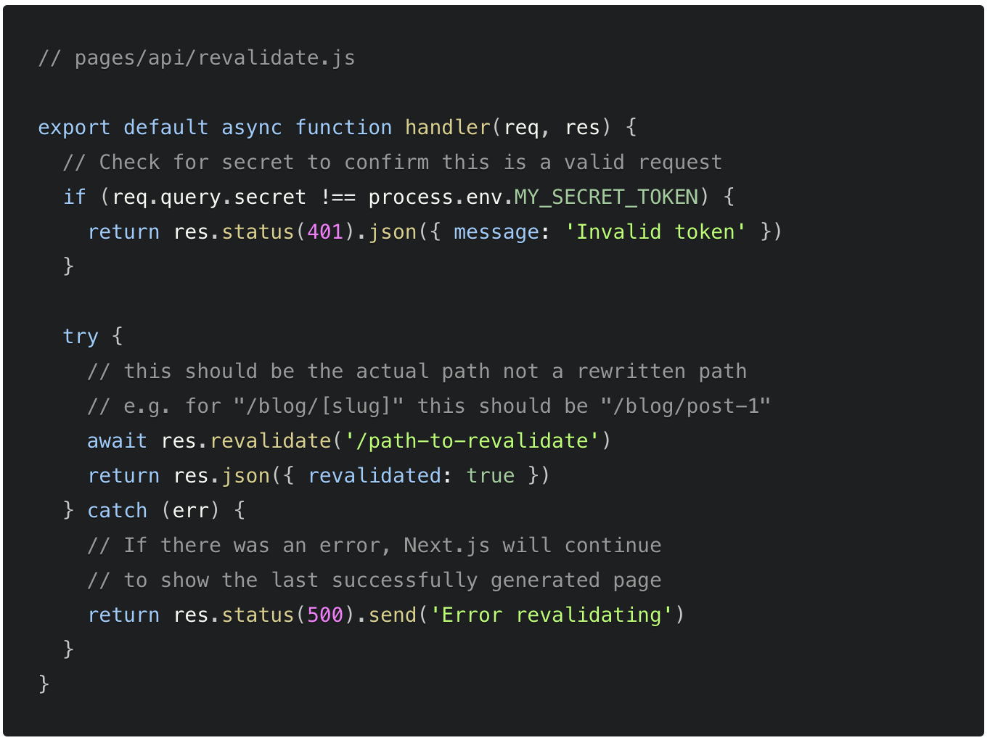
Bonus – On Demand Revalidation
Starting with v12.2.0, Next.js supports On-Demand Incremental Static Regeneration to manually purge the Next.js cache for a specific page. This makes it easier to update your site when:
Content from your headless CMS is created or updated
Ecommerce metadata changes (price, description, category, reviews, etc.)
Notes:
These examples are time based revalidation of the pages after build

Slide 23
Thank You Questions & Feedback

